Slide 1
Carter Co. Highschool - CTC
New Carter County High School
Phase 3: 100% Design Development
August 19th, 2024

Slide 2
Phase 3 Building: Design Process Overview: Current Phase: Design Development (DD’s)

Slide 3
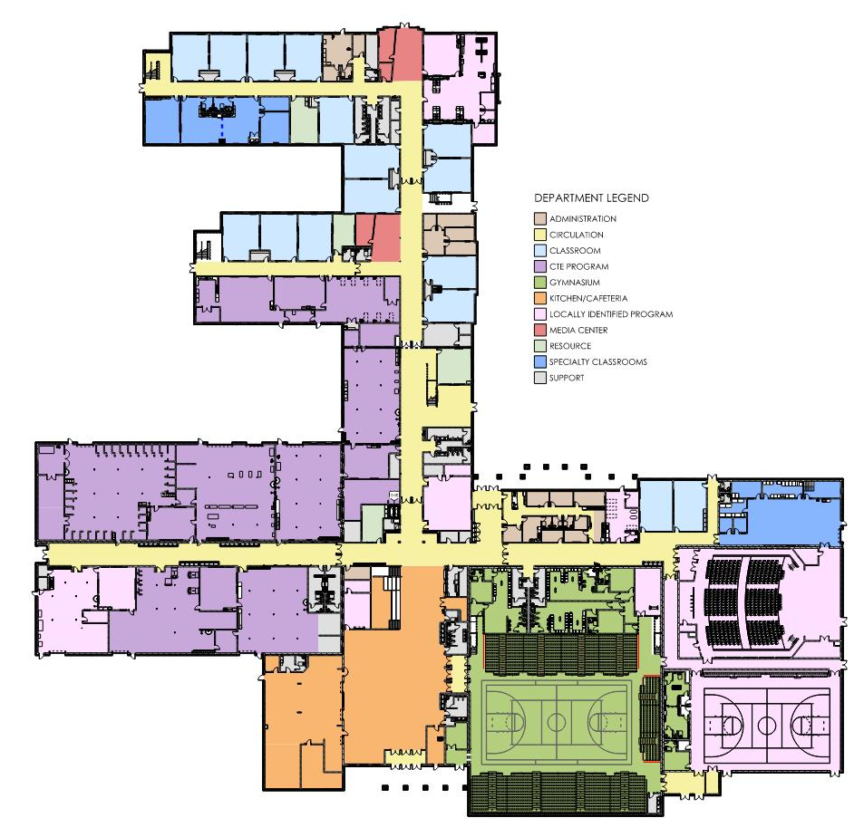
First Floor Plan
148,905 SF

Slide 4
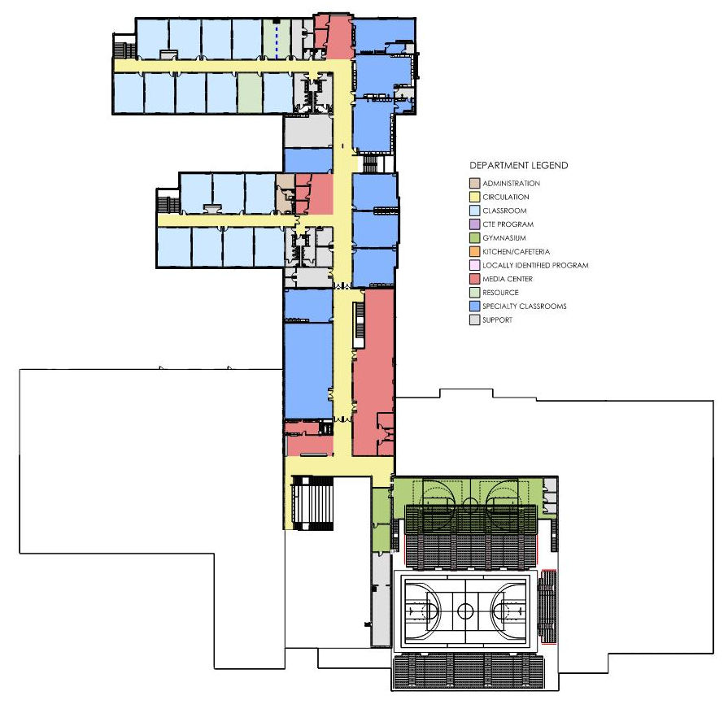
Second Floor Plan
57,211 SF
Total:
206,116 SF

Slide 5
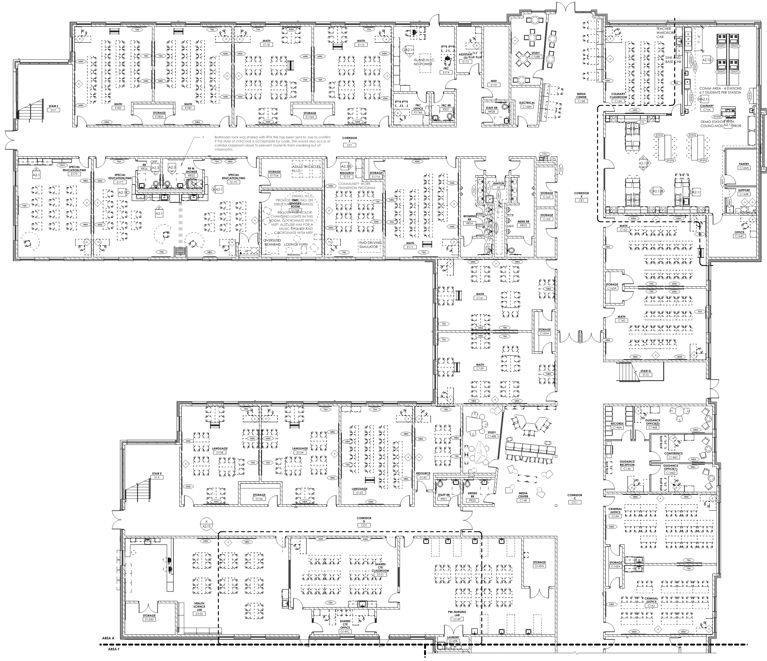
First Floor Area A
MATH
(TYPICAL PAIR)
FMD
CULINARY
GUIDANCE SUITE
SATELLITE MEDIA CENTER (TYPICAL)
LANGUAGE
(TYPICAL PAIR)
PRE-NURSING &
HEALTH SCIENCES (CTE)

Slide 6
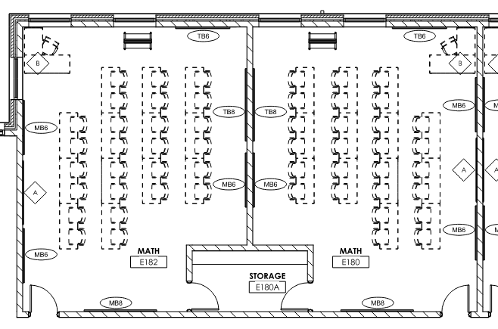
First Floor Area A
MATH (TYPICAL PAIR)

Slide 7
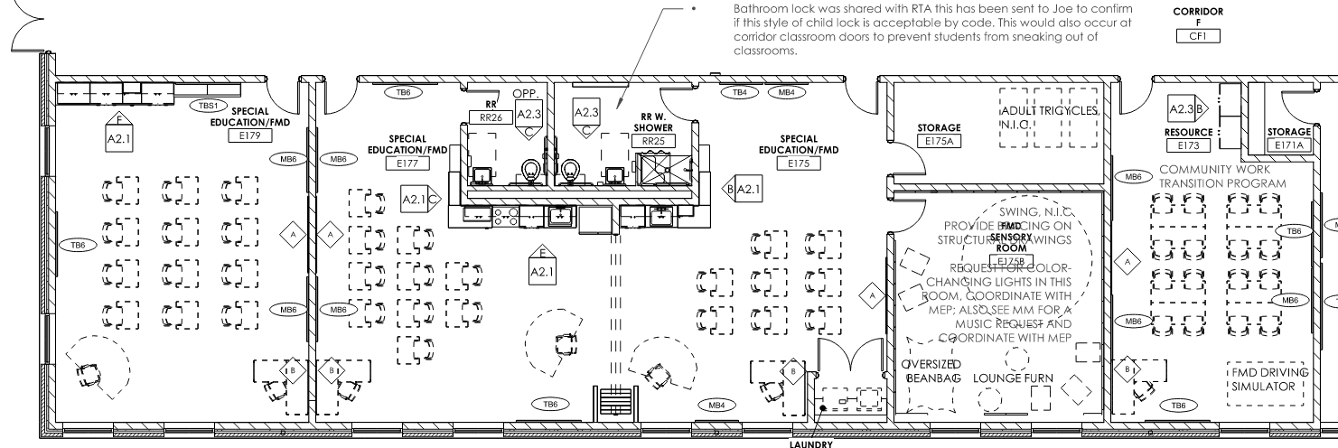
First Floor Area A
FMD / SPECIAL EDUCATION SUITE

Slide 8
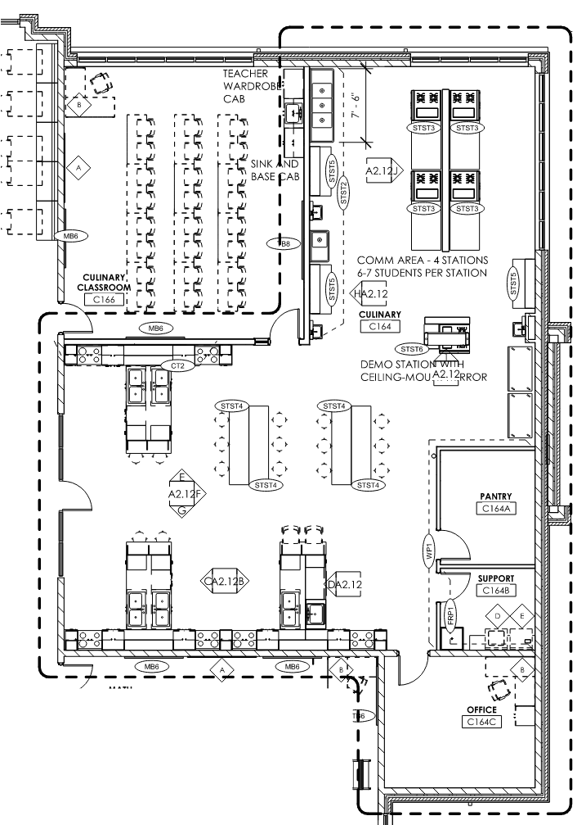
First Floor Area A
CULINARY

Slide 9
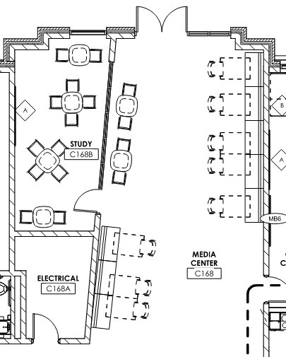
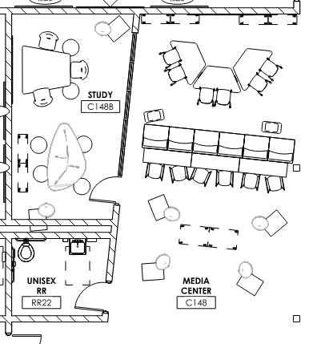
First Floor Area A
VARIATION 1
(AT CORRIDOR JUNCTION)
VARIATION 2
(NEXT DOOR TO CULINARY)
SATELLITE MEDIA CENTER(S)

Slide 10
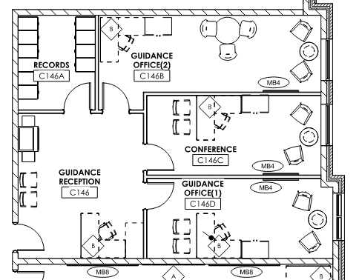
First Floor Area A
GUIDANCE SUITE

Slide 11
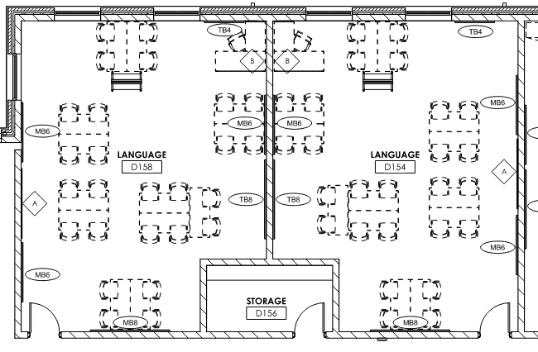
First Floor Area A
LANGUAGE CLASSROOM
(TYPICAL PAIR)

Slide 12
First Floor Area A
HEALTH SCIENCES
SHARED CTE CLASSROOM
PRE-NURSING
PRE-NURSING AND HEALTH SCIENCES

Slide 13
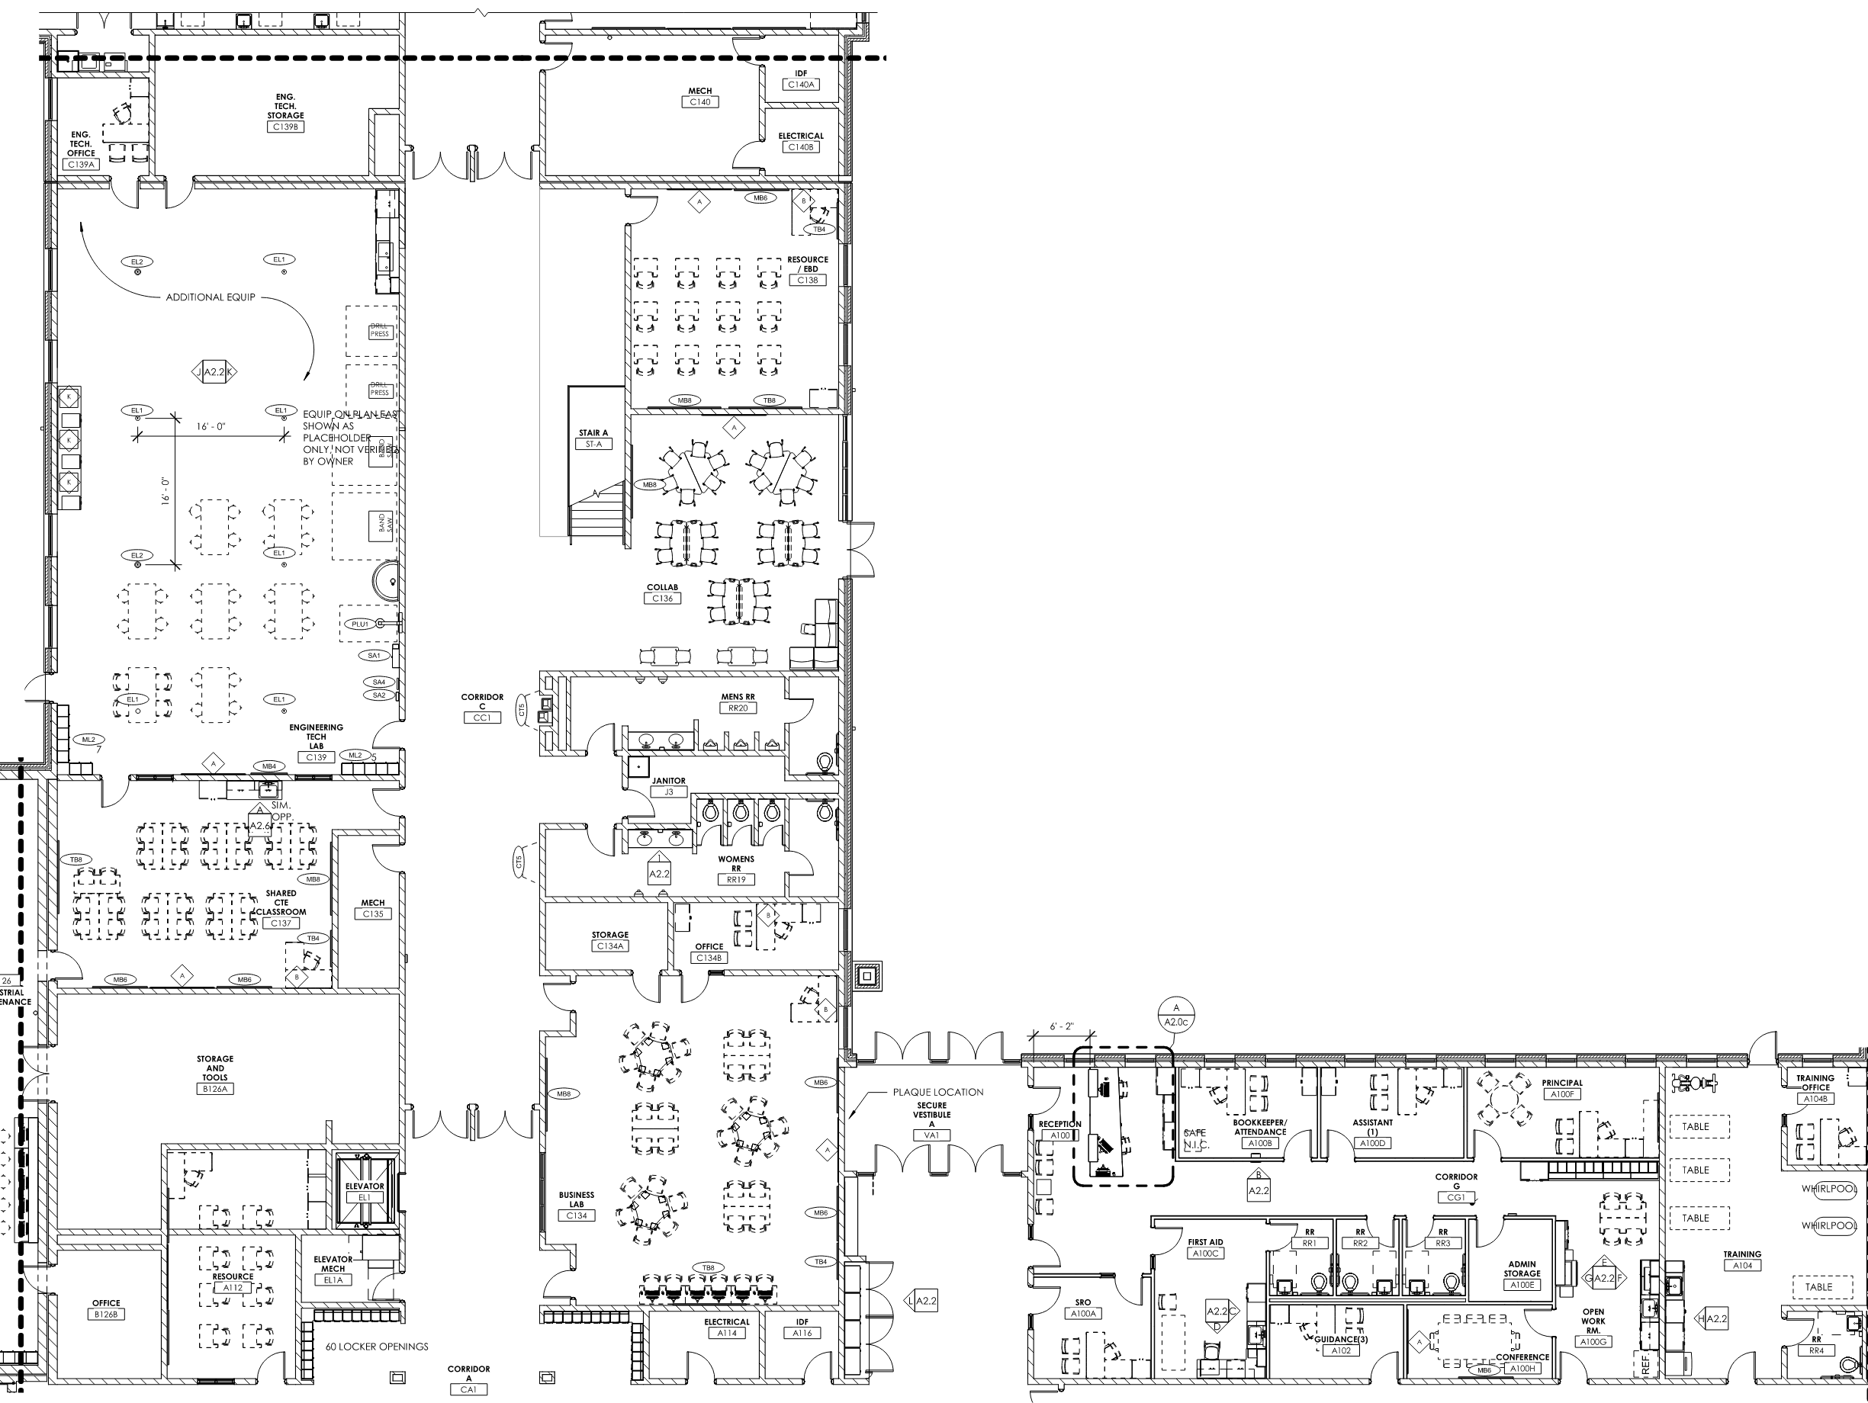
First Floor Area B
ENGINEERING TECH.
RESOURCE / E.B.D.
TRAINING RM.
COLLAB SPACE
ADMINISTRATION SUITE
BUSINESS LAB

Slide 14
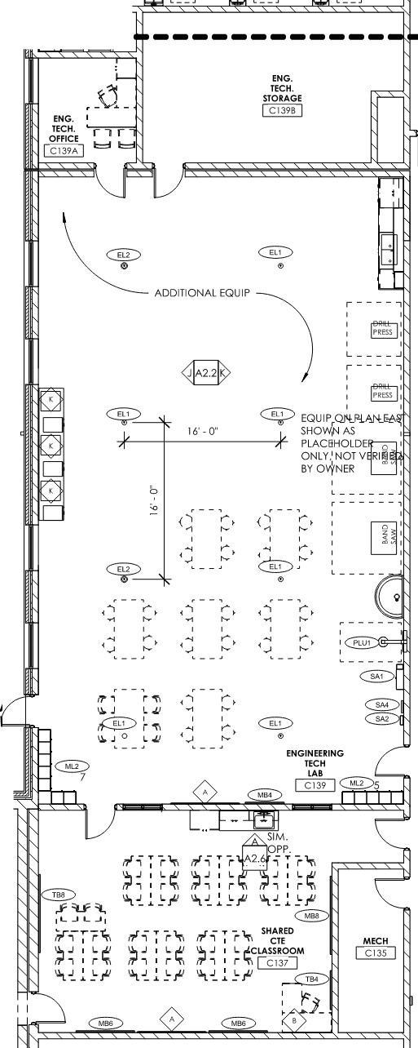
First Floor Area B
ENGINEERING TECHNOLOGY
SHARED CTE CLASSROOM
(SHARES WITH INDUSTRIAL MAINTENANCE)

Slide 15
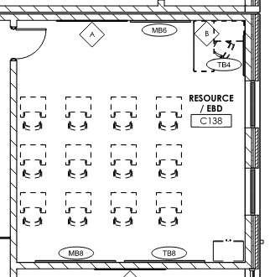
First Floor Area B
RESOURCE / E.B.D. ROOM

Slide 16
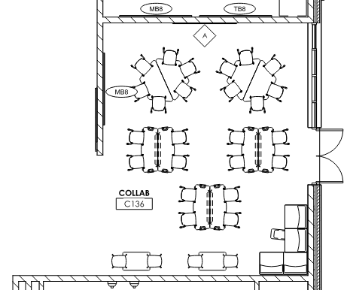
First Floor Area B
OPEN COLLABORATION SPACE

Slide 17
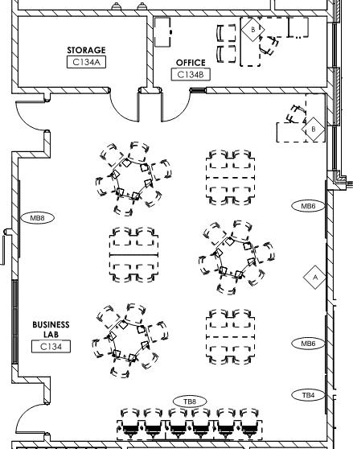
First Floor Area B
BUSINESS LAB

Slide 18
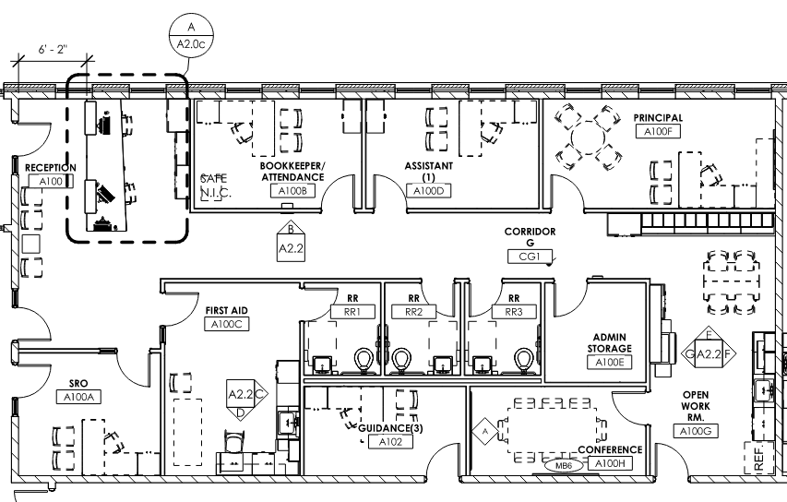
First Floor Area B
ADMINISTRATION SUITE

Slide 19
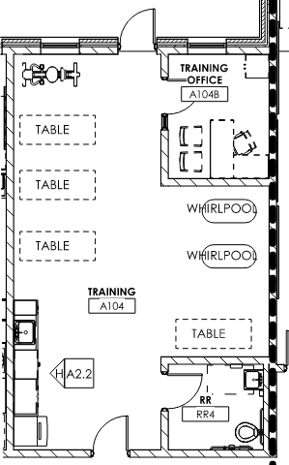
First Floor Area B
TRAINING ROOM

Slide 20
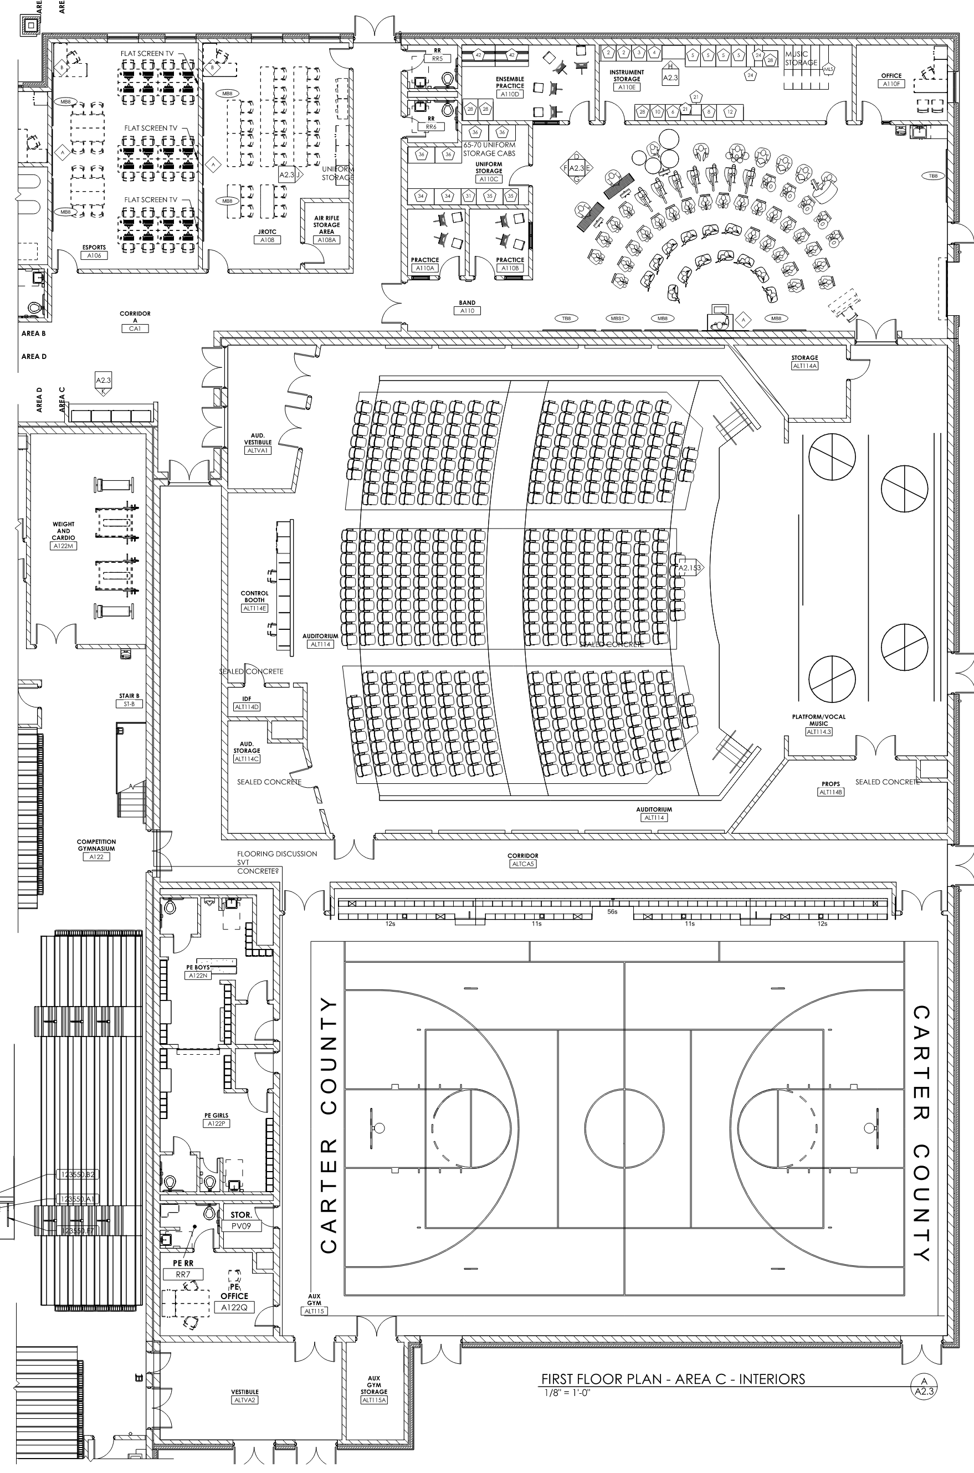
First Floor Area C
BAND ROOM
ESPORTS
AUDITORIUM
JROTC
AUXILIARY GYMNASIUM
P.E. LOCKERS

Slide 21
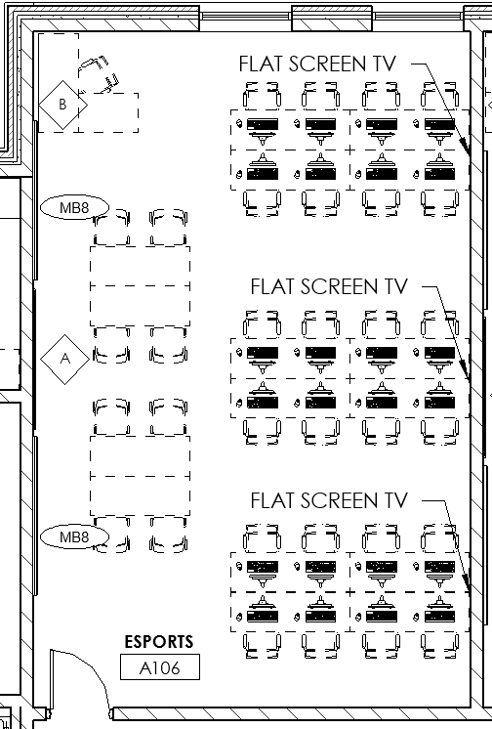
First Floor Area C
ESPORTS

Slide 22
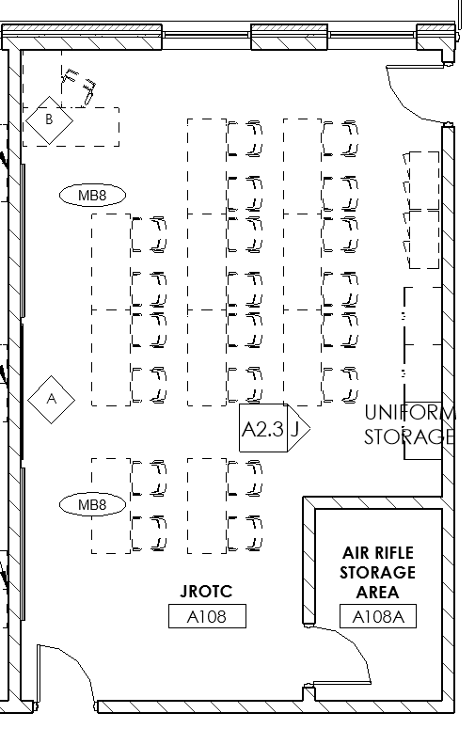
First Floor Area C
REQUIRES A
2-LOCK SYSTEM
JROTC

Slide 23
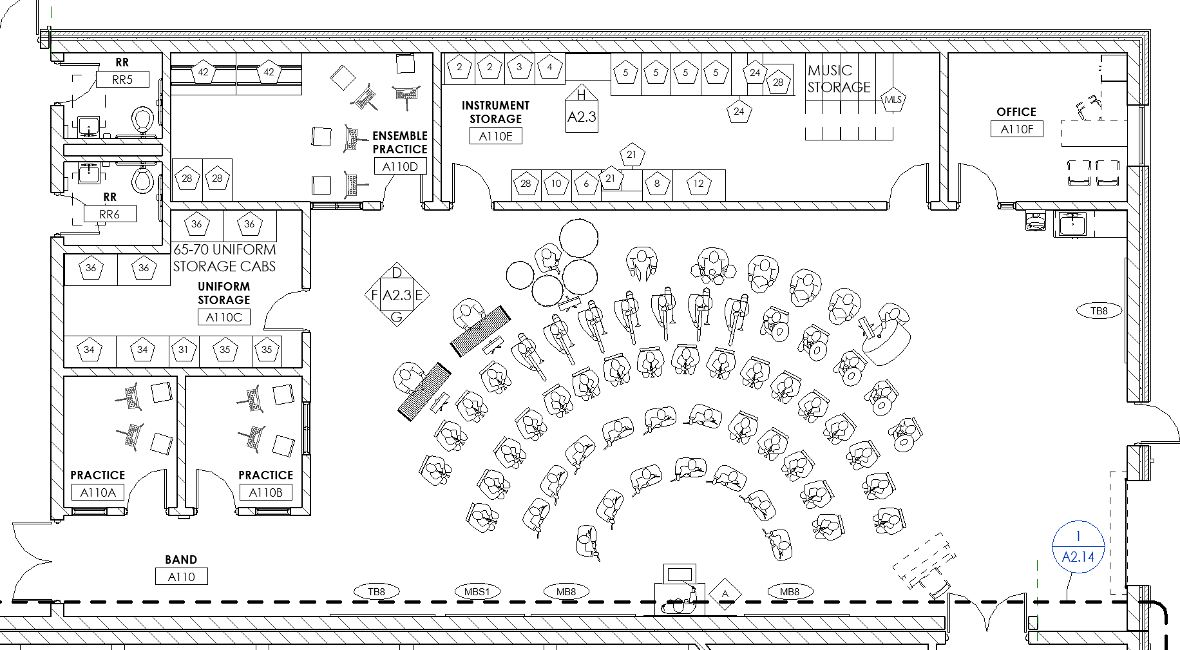
First Floor Area C
BAND

Slide 24
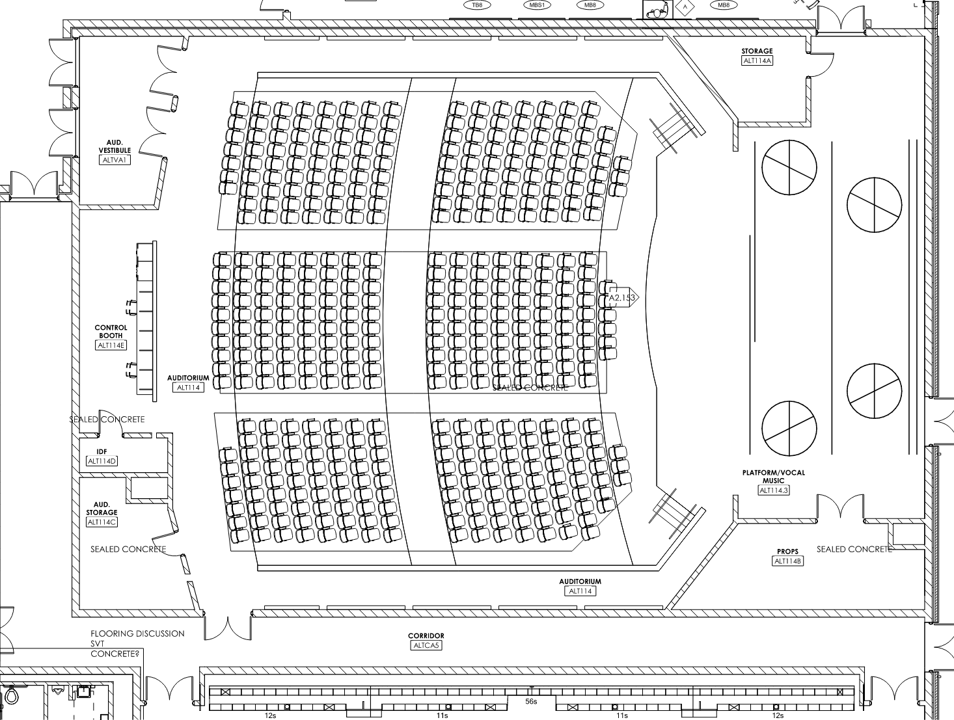
First Floor Area C
AUDITORIUM

Slide 25
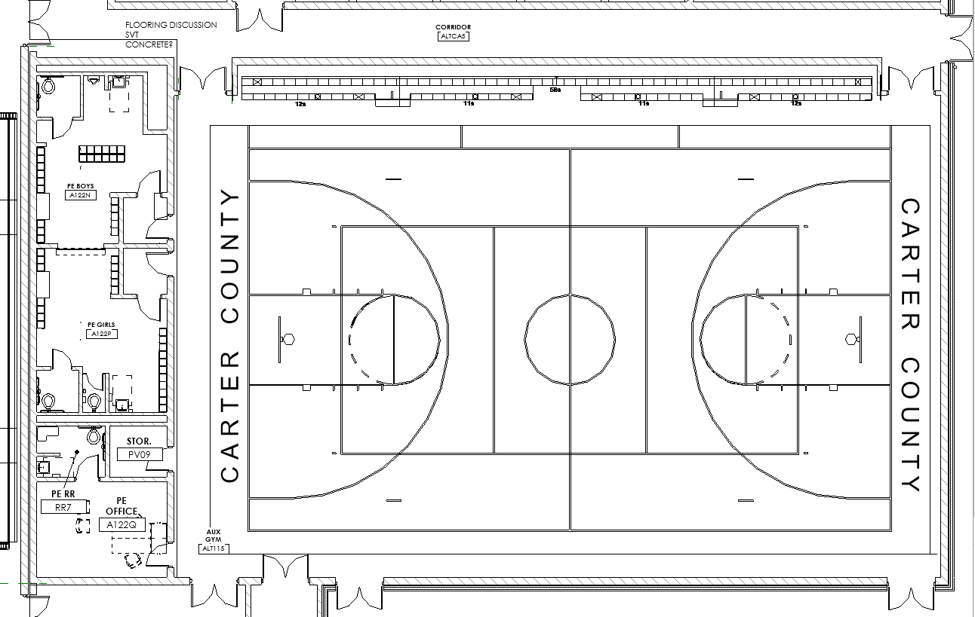
First Floor Area C
AUXILIARY GYMNASIUM WITH P.E. LOCKER ROOMS

Slide 26
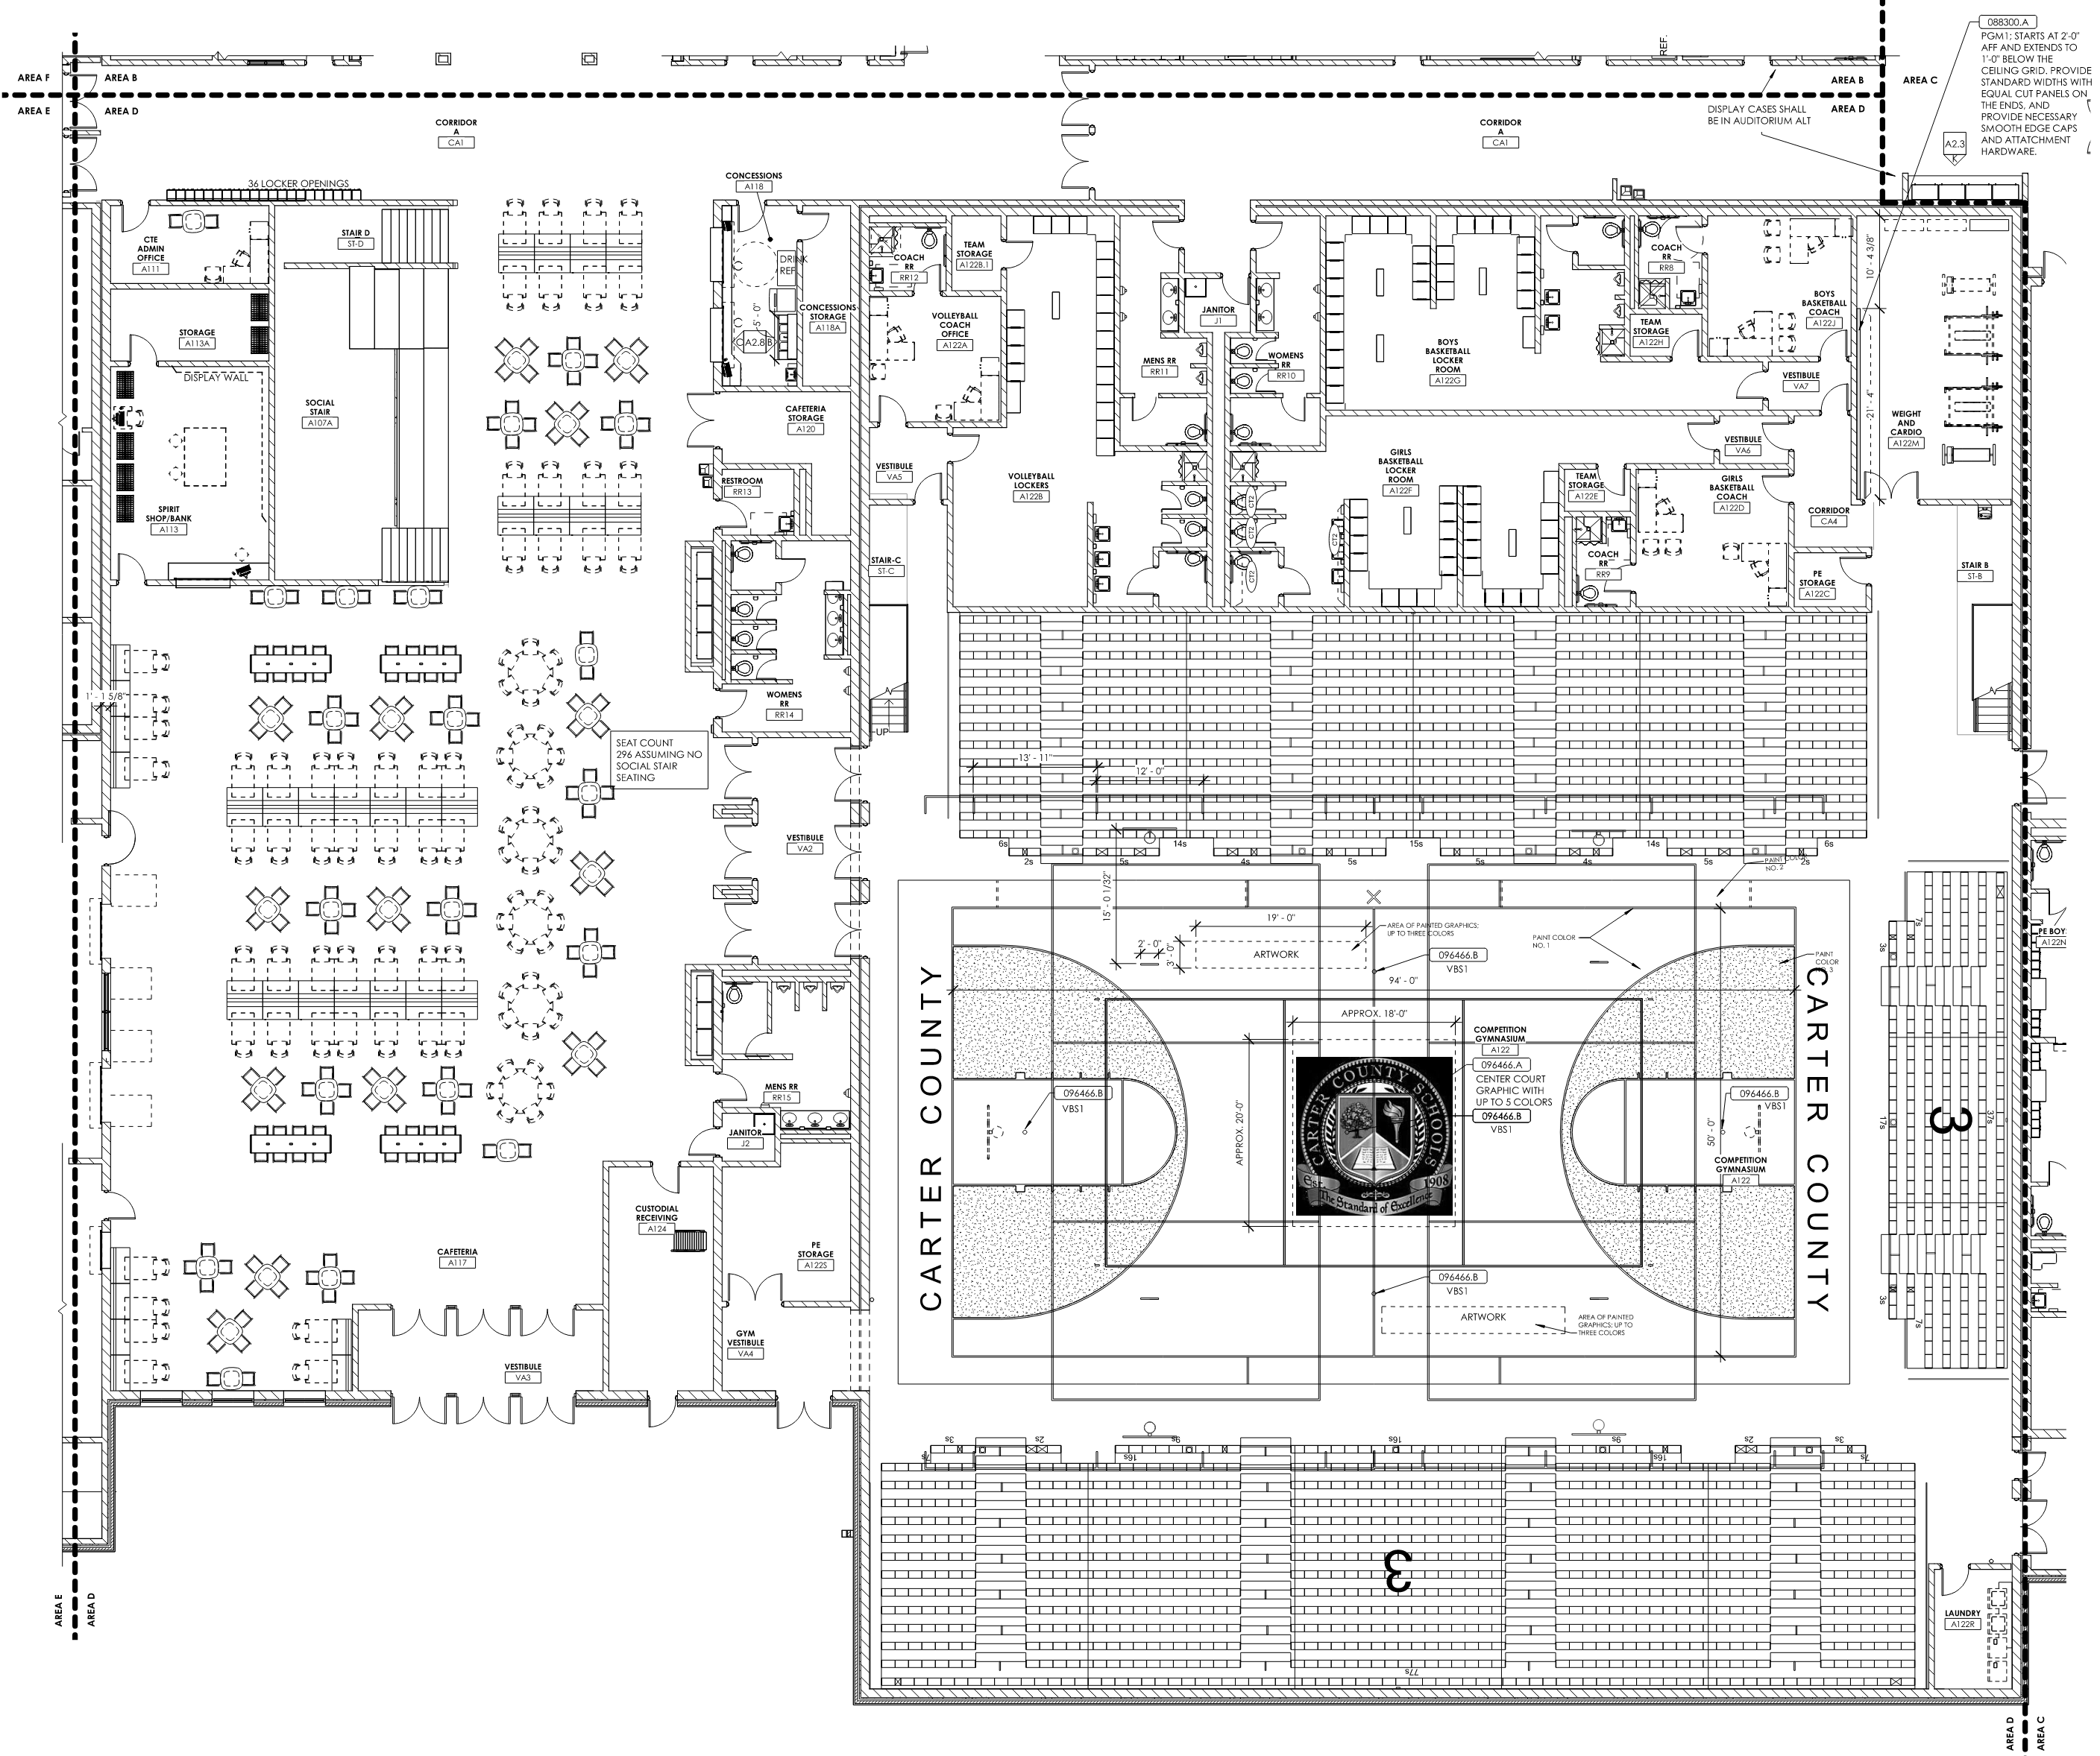
First Floor Area D
CTE OFFICE
AND SPIRIT SHOP/BANK
CAFETERIA
COMPETITION GYMNASIUM

Slide 27
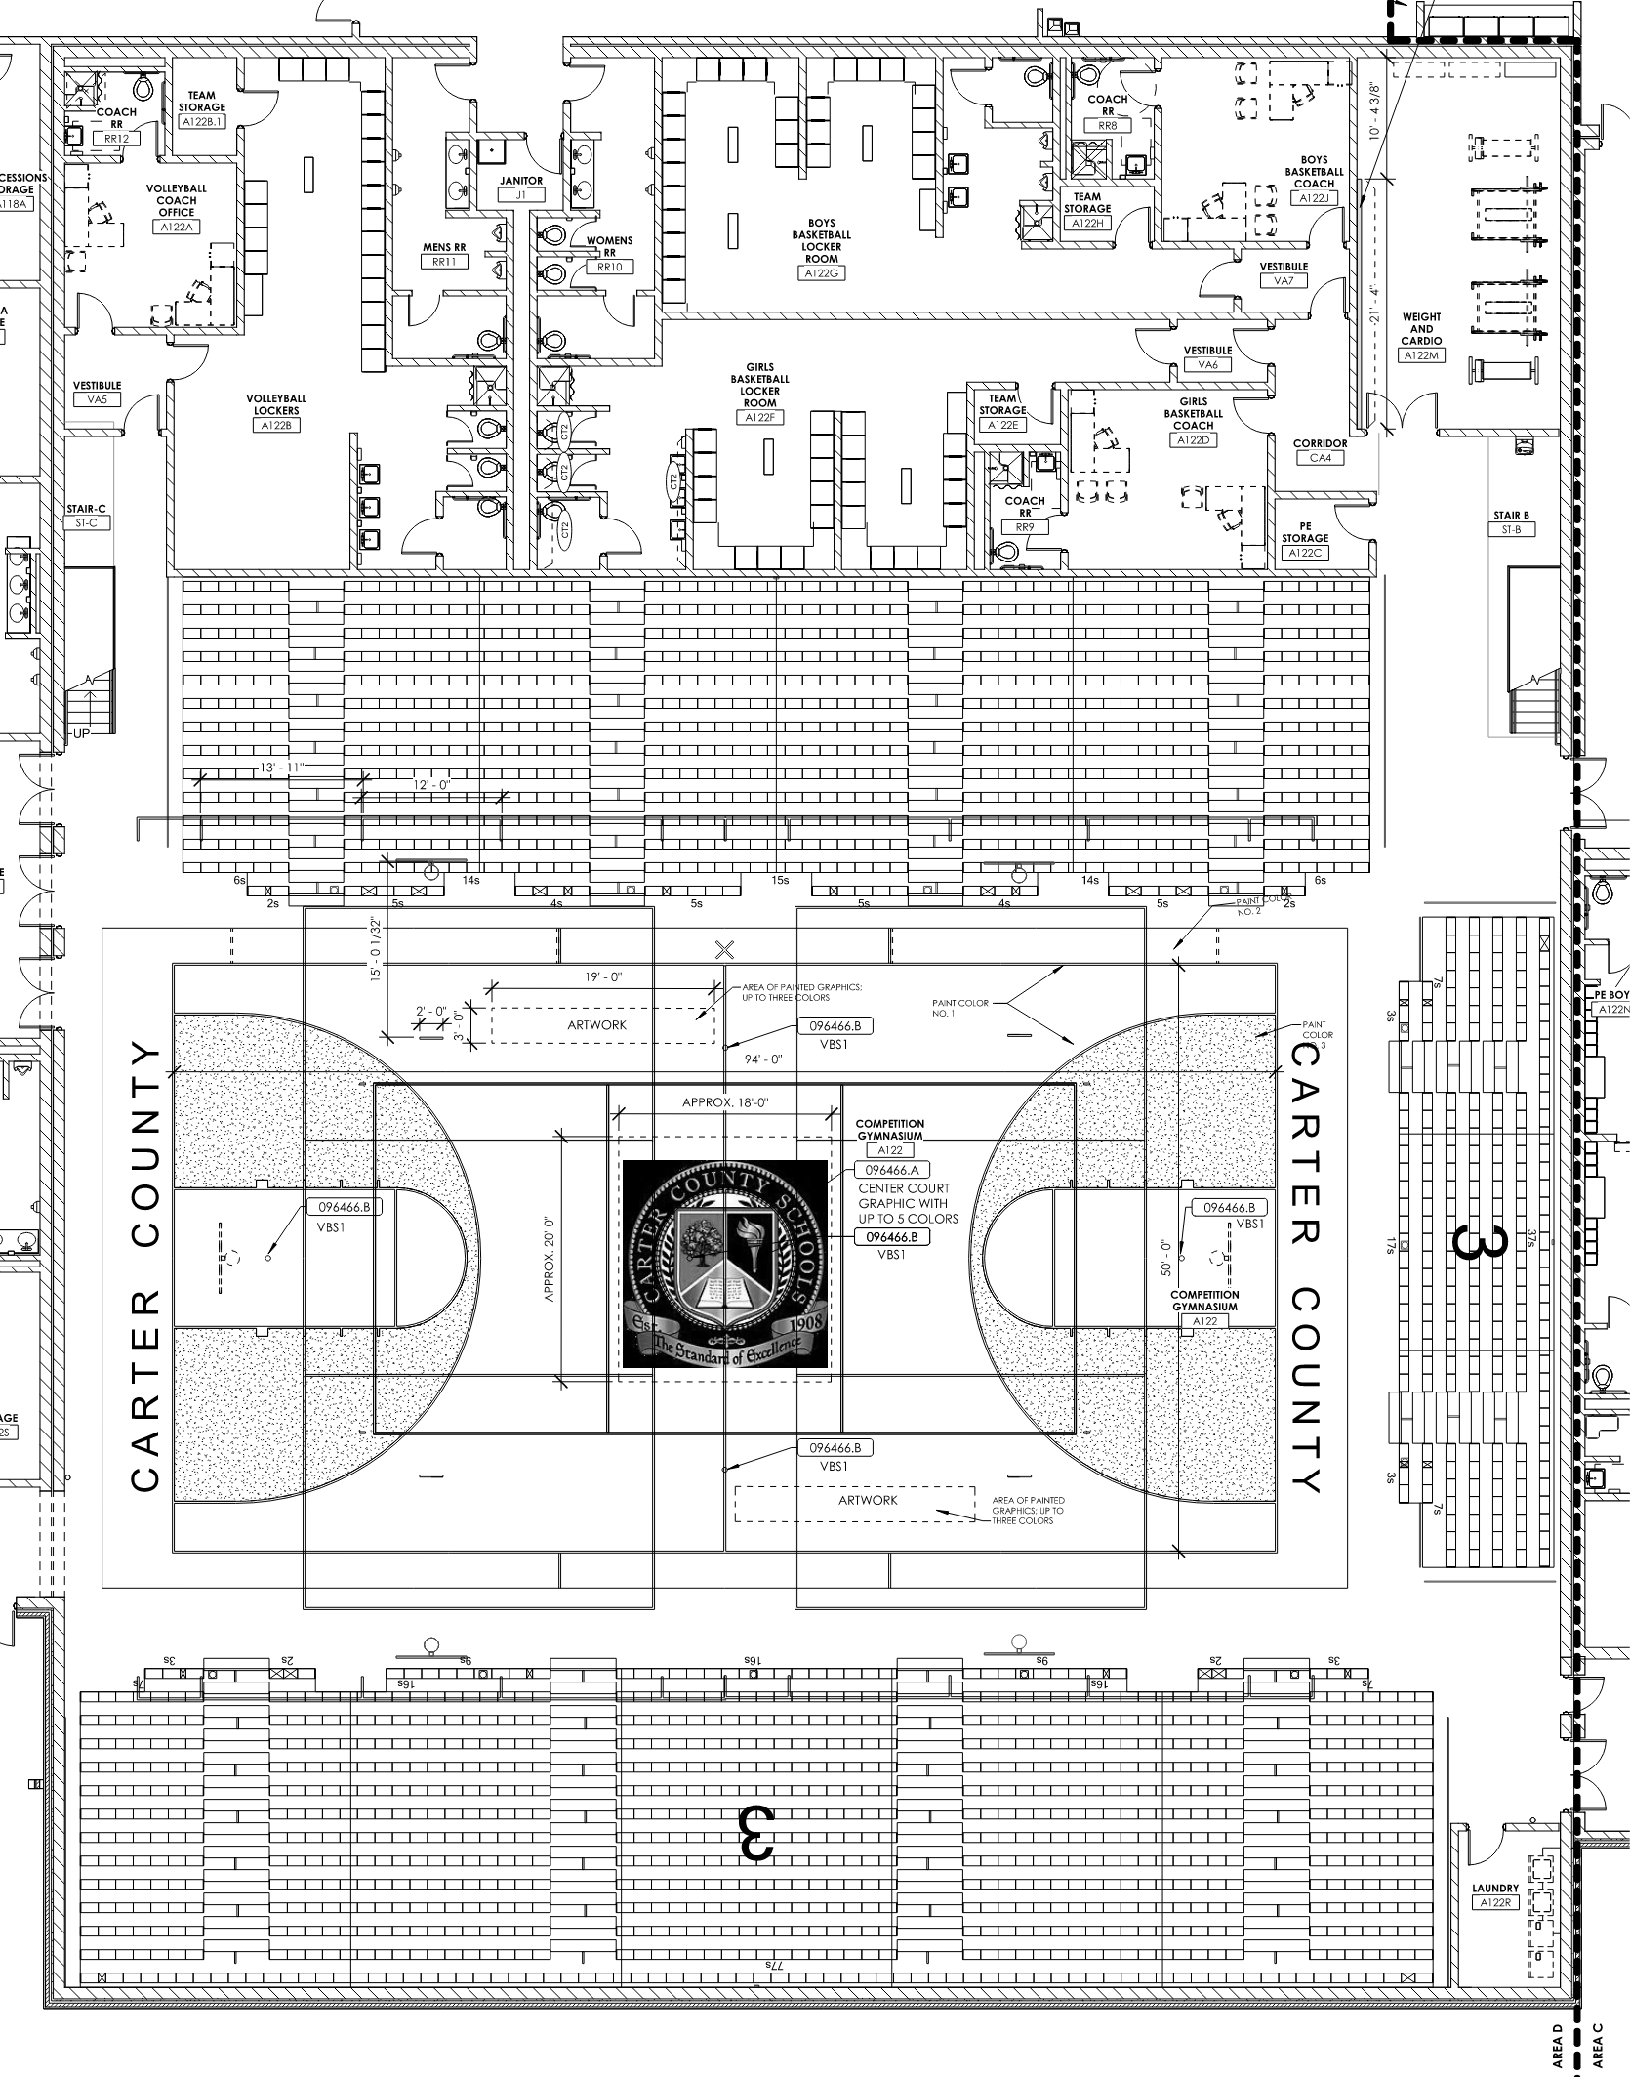
First Floor Area D
COMPETITION GYMNASIUM

Slide 28
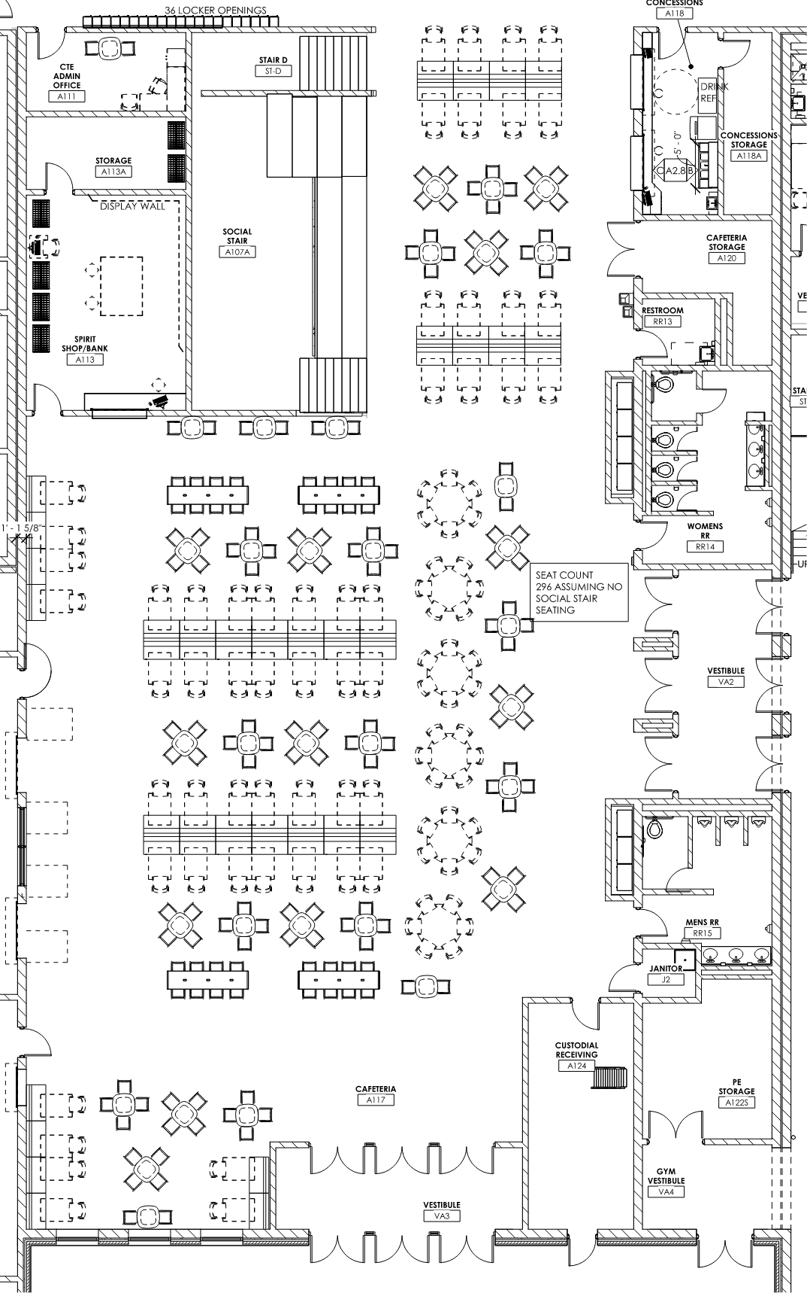
First Floor Area D
CONCESSIONS
CAFETERIA STORAGE
SOCIAL STAIR
ENTRANCE TO COMPETITION GYM
KITCHEN SIDE
CAFETERIA

Slide 29
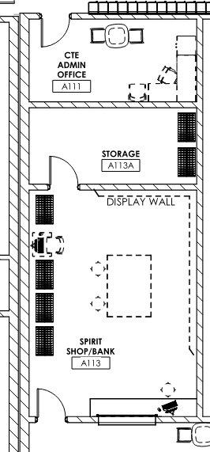
First Floor Area D
CTE ADMIN OFFICE
SPIRIT SHOP/BANK
SPIRIT SHOP / BANK & CTE OFFICE

Slide 30
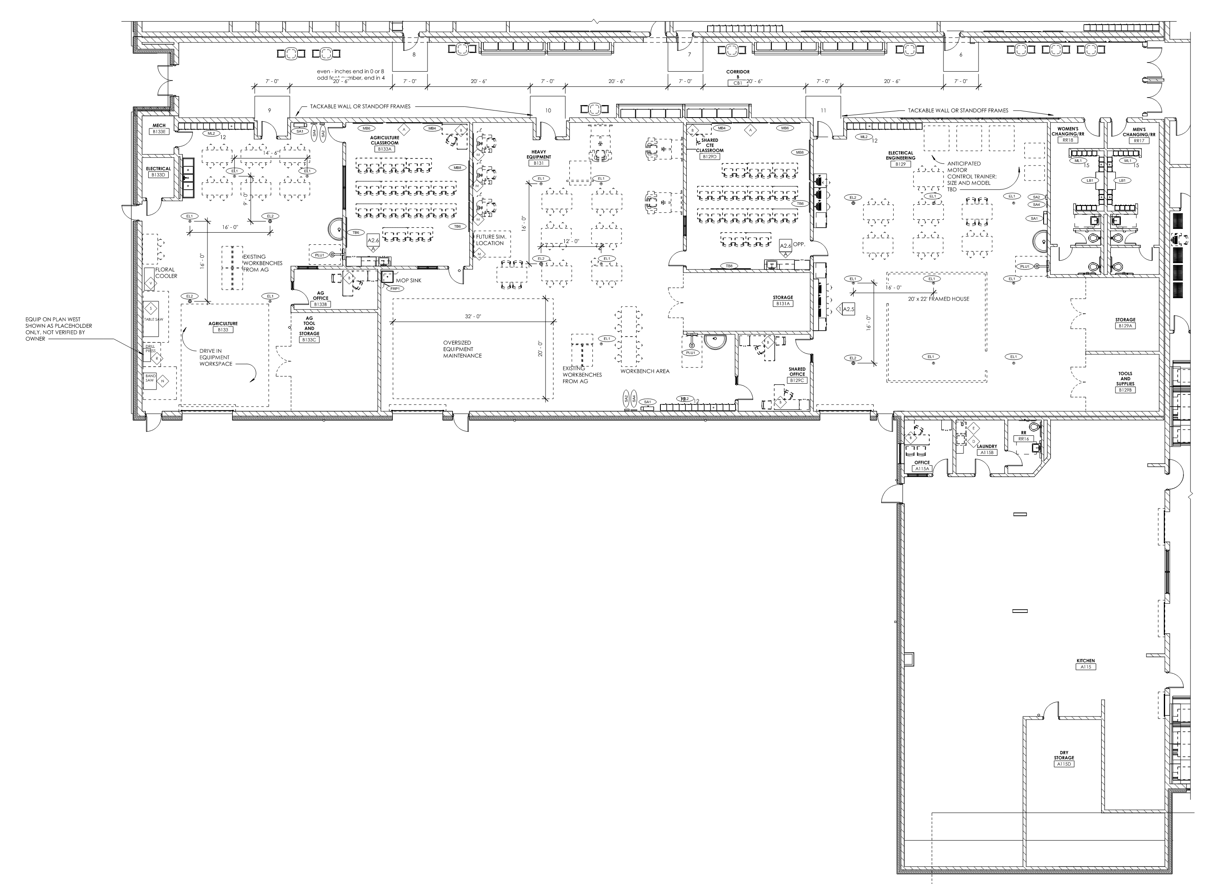
First Floor Area E
AGRICULTURE
HEAVY EQUIPMENT
ELECTRICAL ENGINEERING
CAFETERIA KITCHEN

Slide 31
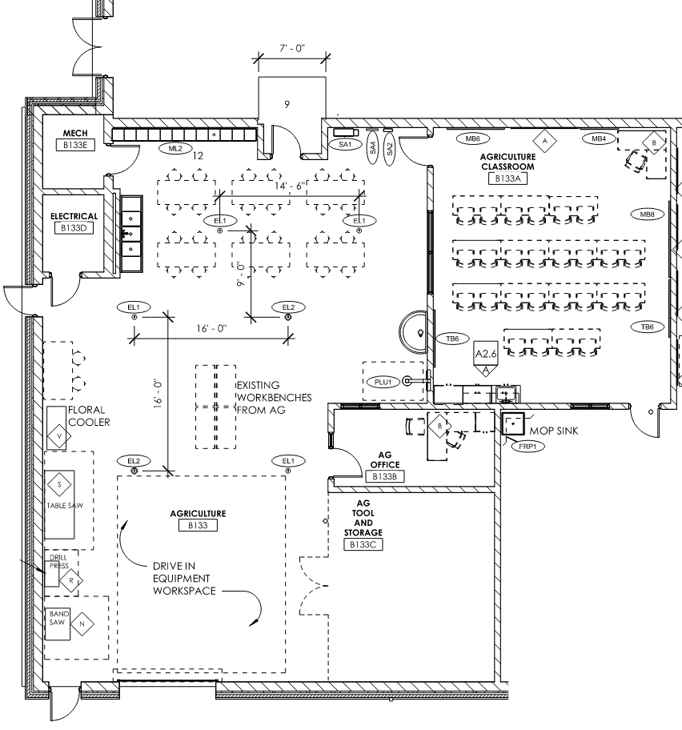
First Floor Area E
SHARED CTE CLASSROOM
(SHARES WITH HEAVY EQUIPMENT)
ENTRY TO HEAVY EQUIPMENT LAB
AGRICULTURE

Slide 32
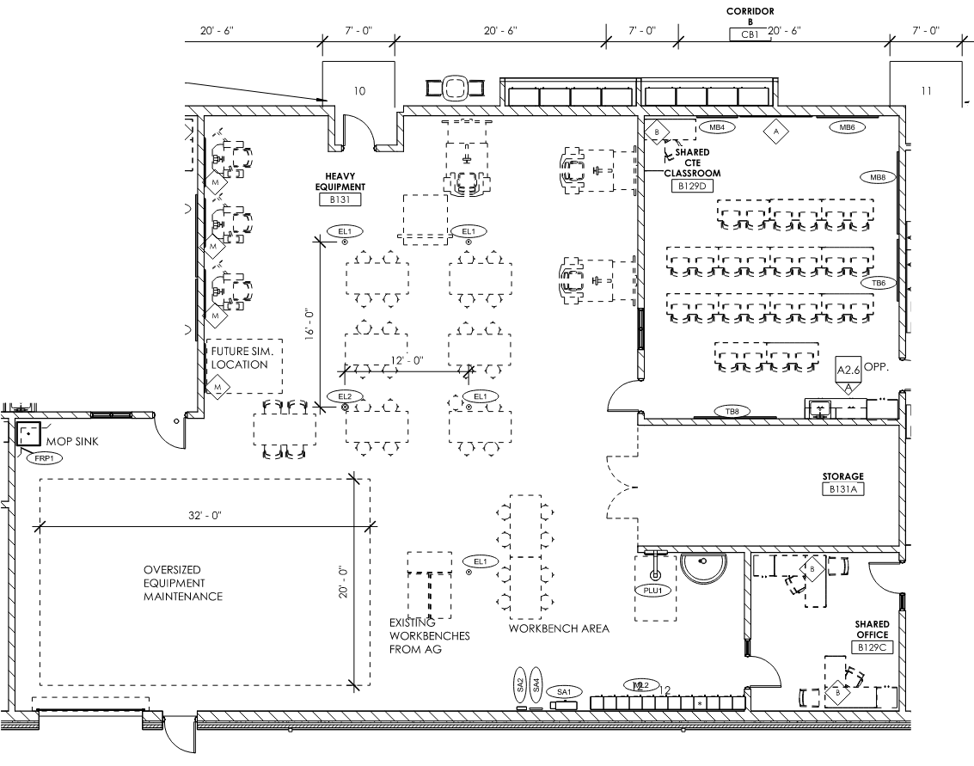
First Floor Area E
ENTRY TO AG. CLASSROOM
SHARED CTE
CLASSROOM
(SHARES WITH ELECTRICAL ENGINEERING)
HEAVY EQUIPMENT

Slide 33
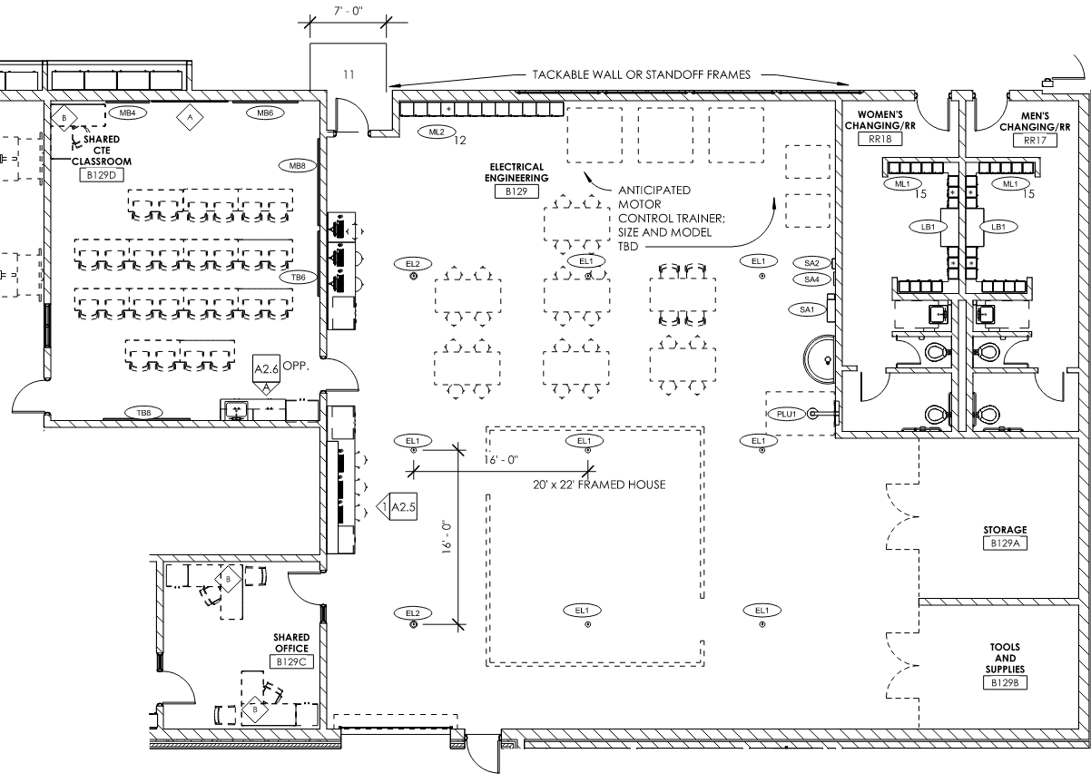
First Floor Area E
SHARED CTE CLASSROOM
(SHARES WITH HEAVY EQUIPMENT)
ELECTRICAL ENGINEERING

Slide 34
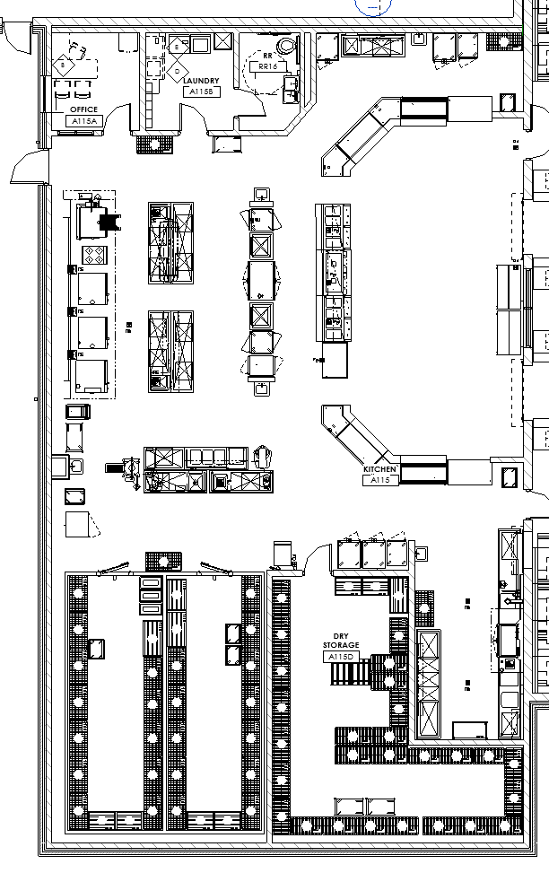
First Floor Area E
CAFETERIA KITCHEN

Slide 35
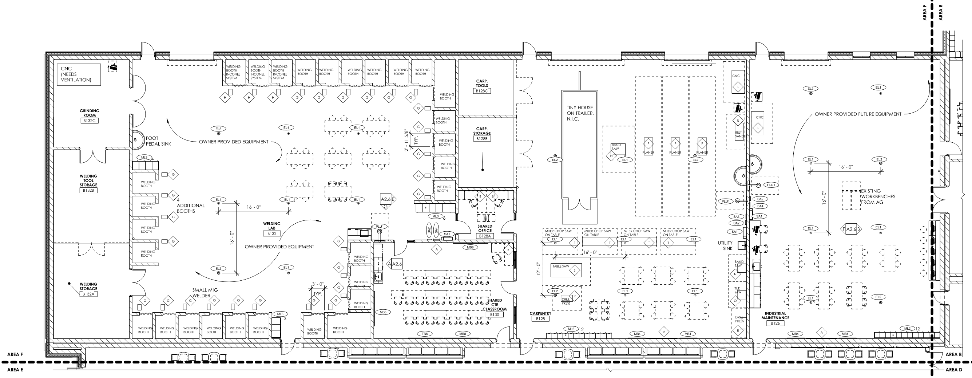
First Floor Area F
INDUSTRIAL MAINTENANCE
WELDING
CARPENTRY

Slide 36
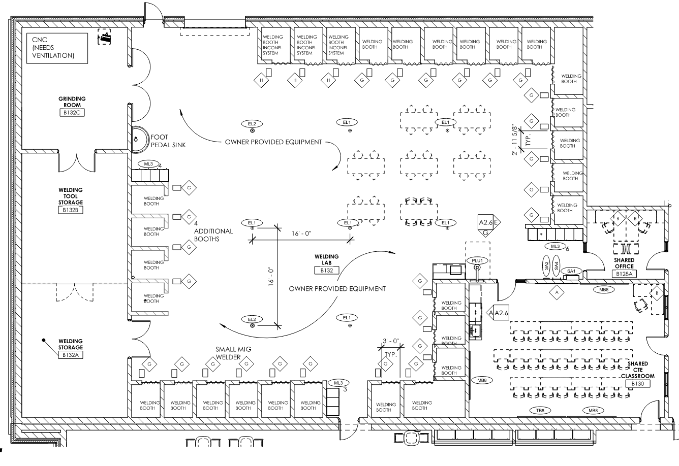
First Floor Area F
SHARED CTE CLASSROOM
(SHARES WITH CARPENTRY)
WELDING

Slide 37
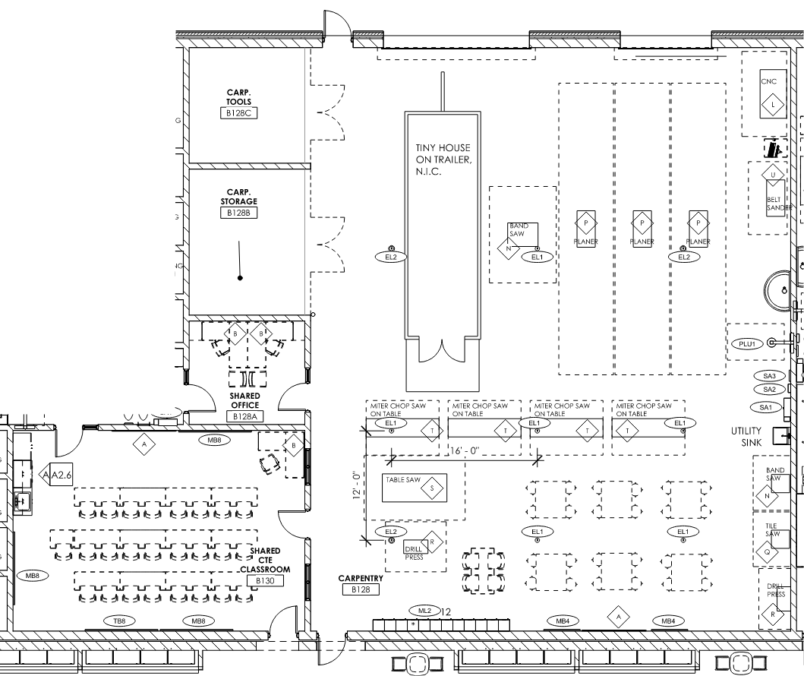
First Floor Area F
SHARED CTE CLASSROOM
(SHARES WITH WELDING)
CARPENTRY

Slide 38
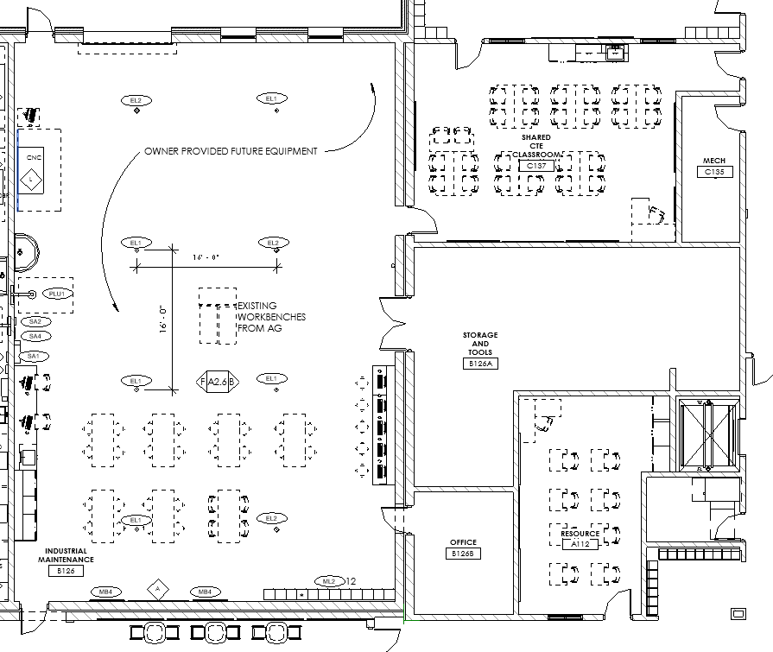
First Floor Area F
SHARED CTE CLASSROOM
(SHARES WITH ENGINEERING TECH)
INDUSTRIAL MAINTENANCE

Slide 39
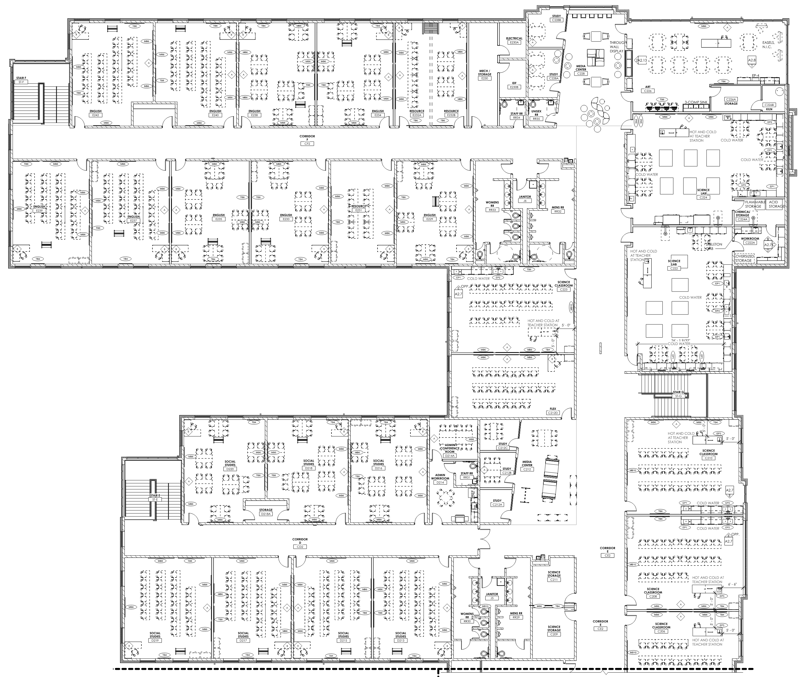
Second Floor Area A
ART
ENGLISH (TYPICAL PAIR)
FLEX SPACE
SCIENCE
LAB
ADMINISTRATION SATELLITE
SOCIAL STUDIES
(TYPICAL PAIR)
SCIENCE CLASSROOM
SATELLITE MEDIA CENTER

Slide 40
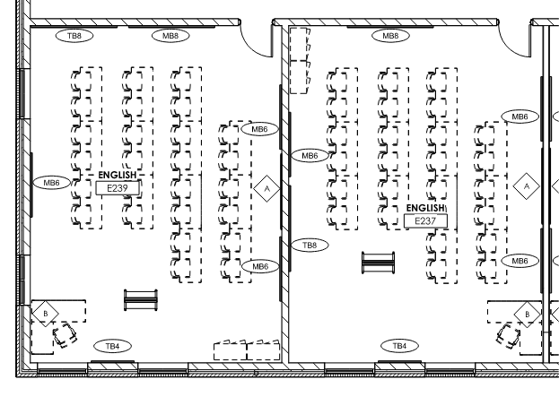
Second Floor Area A
ENGLISH (TYPICAL PAIR)

Slide 41
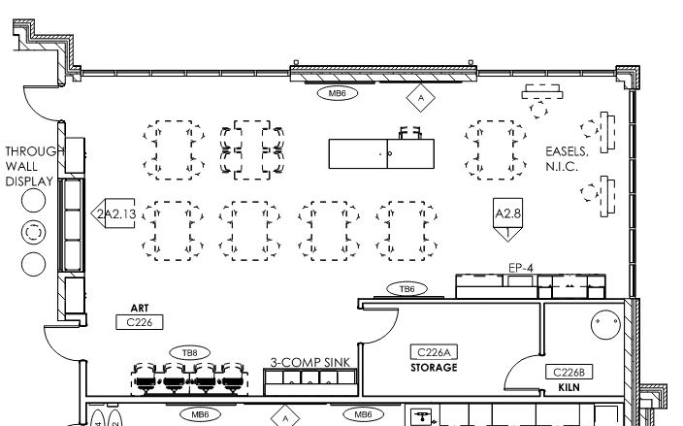
Second Floor Area A
ART

Slide 42
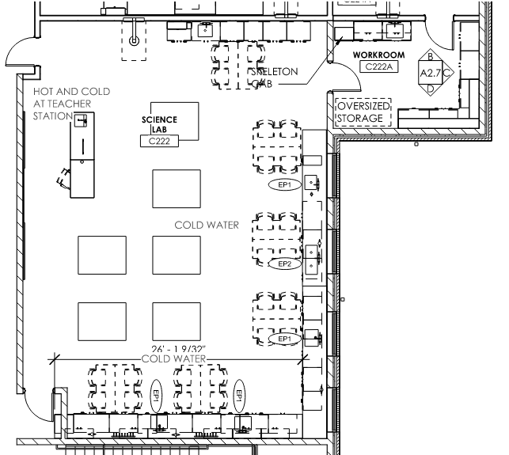
Second Floor Area A
SCIENCE LAB

Slide 43
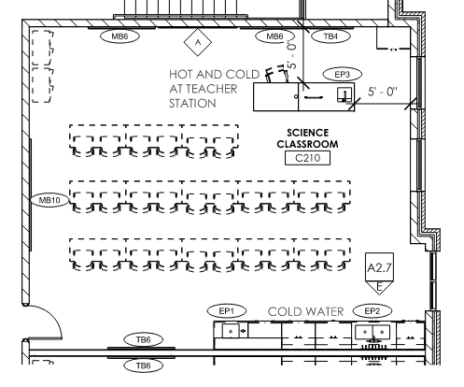
Second Floor Area A
ENGLISH (TYPICAL PAIR)

Slide 44
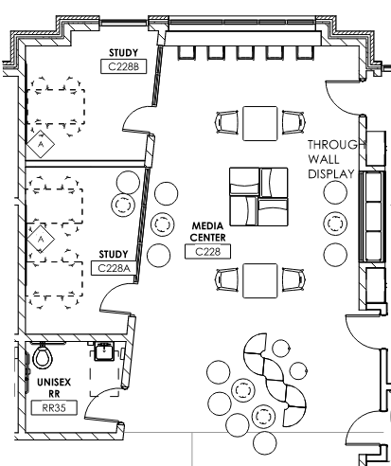
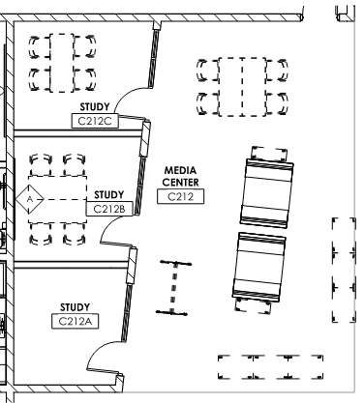
Second Floor Area A
VARIATION 1
(NEXT DOOR TO ART ROOM)
VARIATION 2
(AT CORRIDOR INTERSECTION)
SATELLITE MEDIA CENTERS

Slide 45
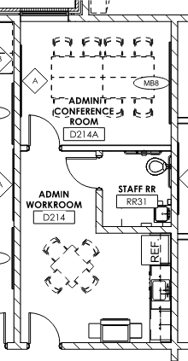
Second Floor Area A
ADMINISTRATION SATELLITE

Slide 46
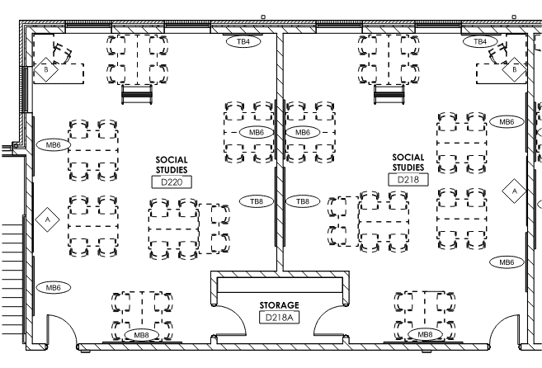
Second Floor Area A
SOCIAL STUDIES (TYPICAL PAIR)

Slide 47
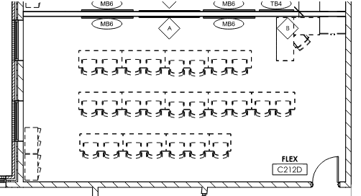
Second Floor Area A
FLEX SPACE

Slide 48
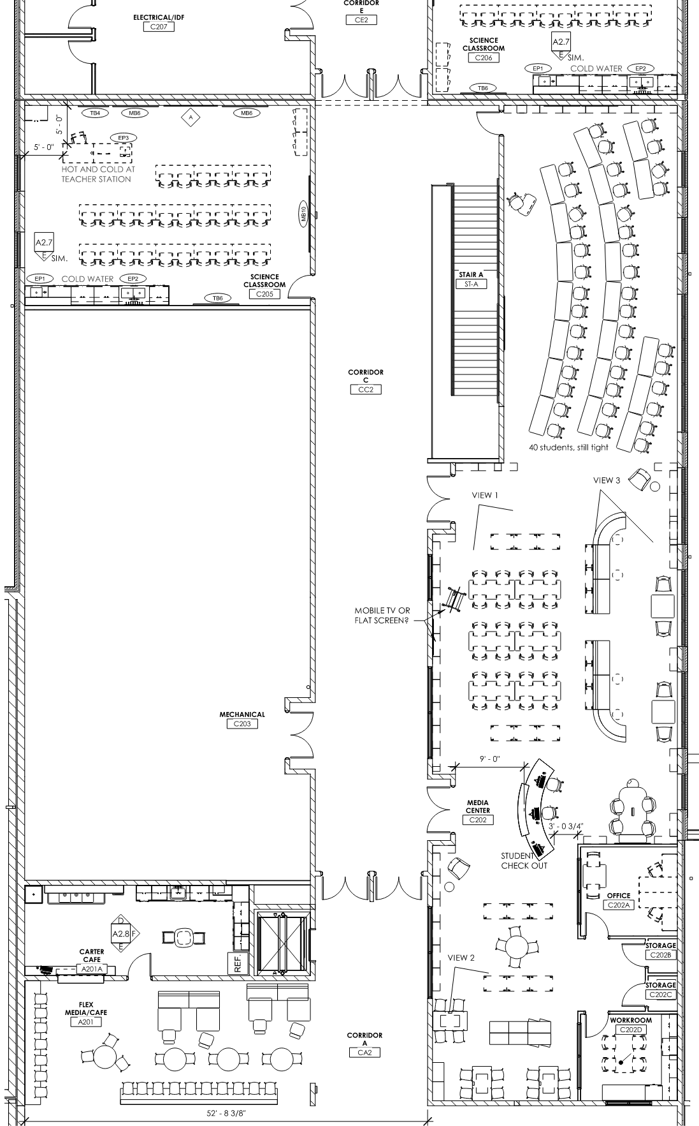
Second Floor Area B
MEDIA CENTER HUB
CARTER CAFE

Slide 49
Second Floor Area B
MEDIA CENTER HUB
(ROTATED TO FIT PAGE)

Slide 50
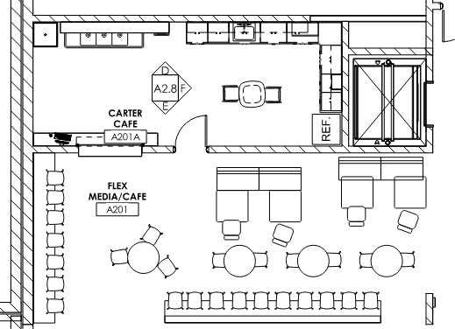
Second Floor Area B
CARTER CAFE

Slide 51
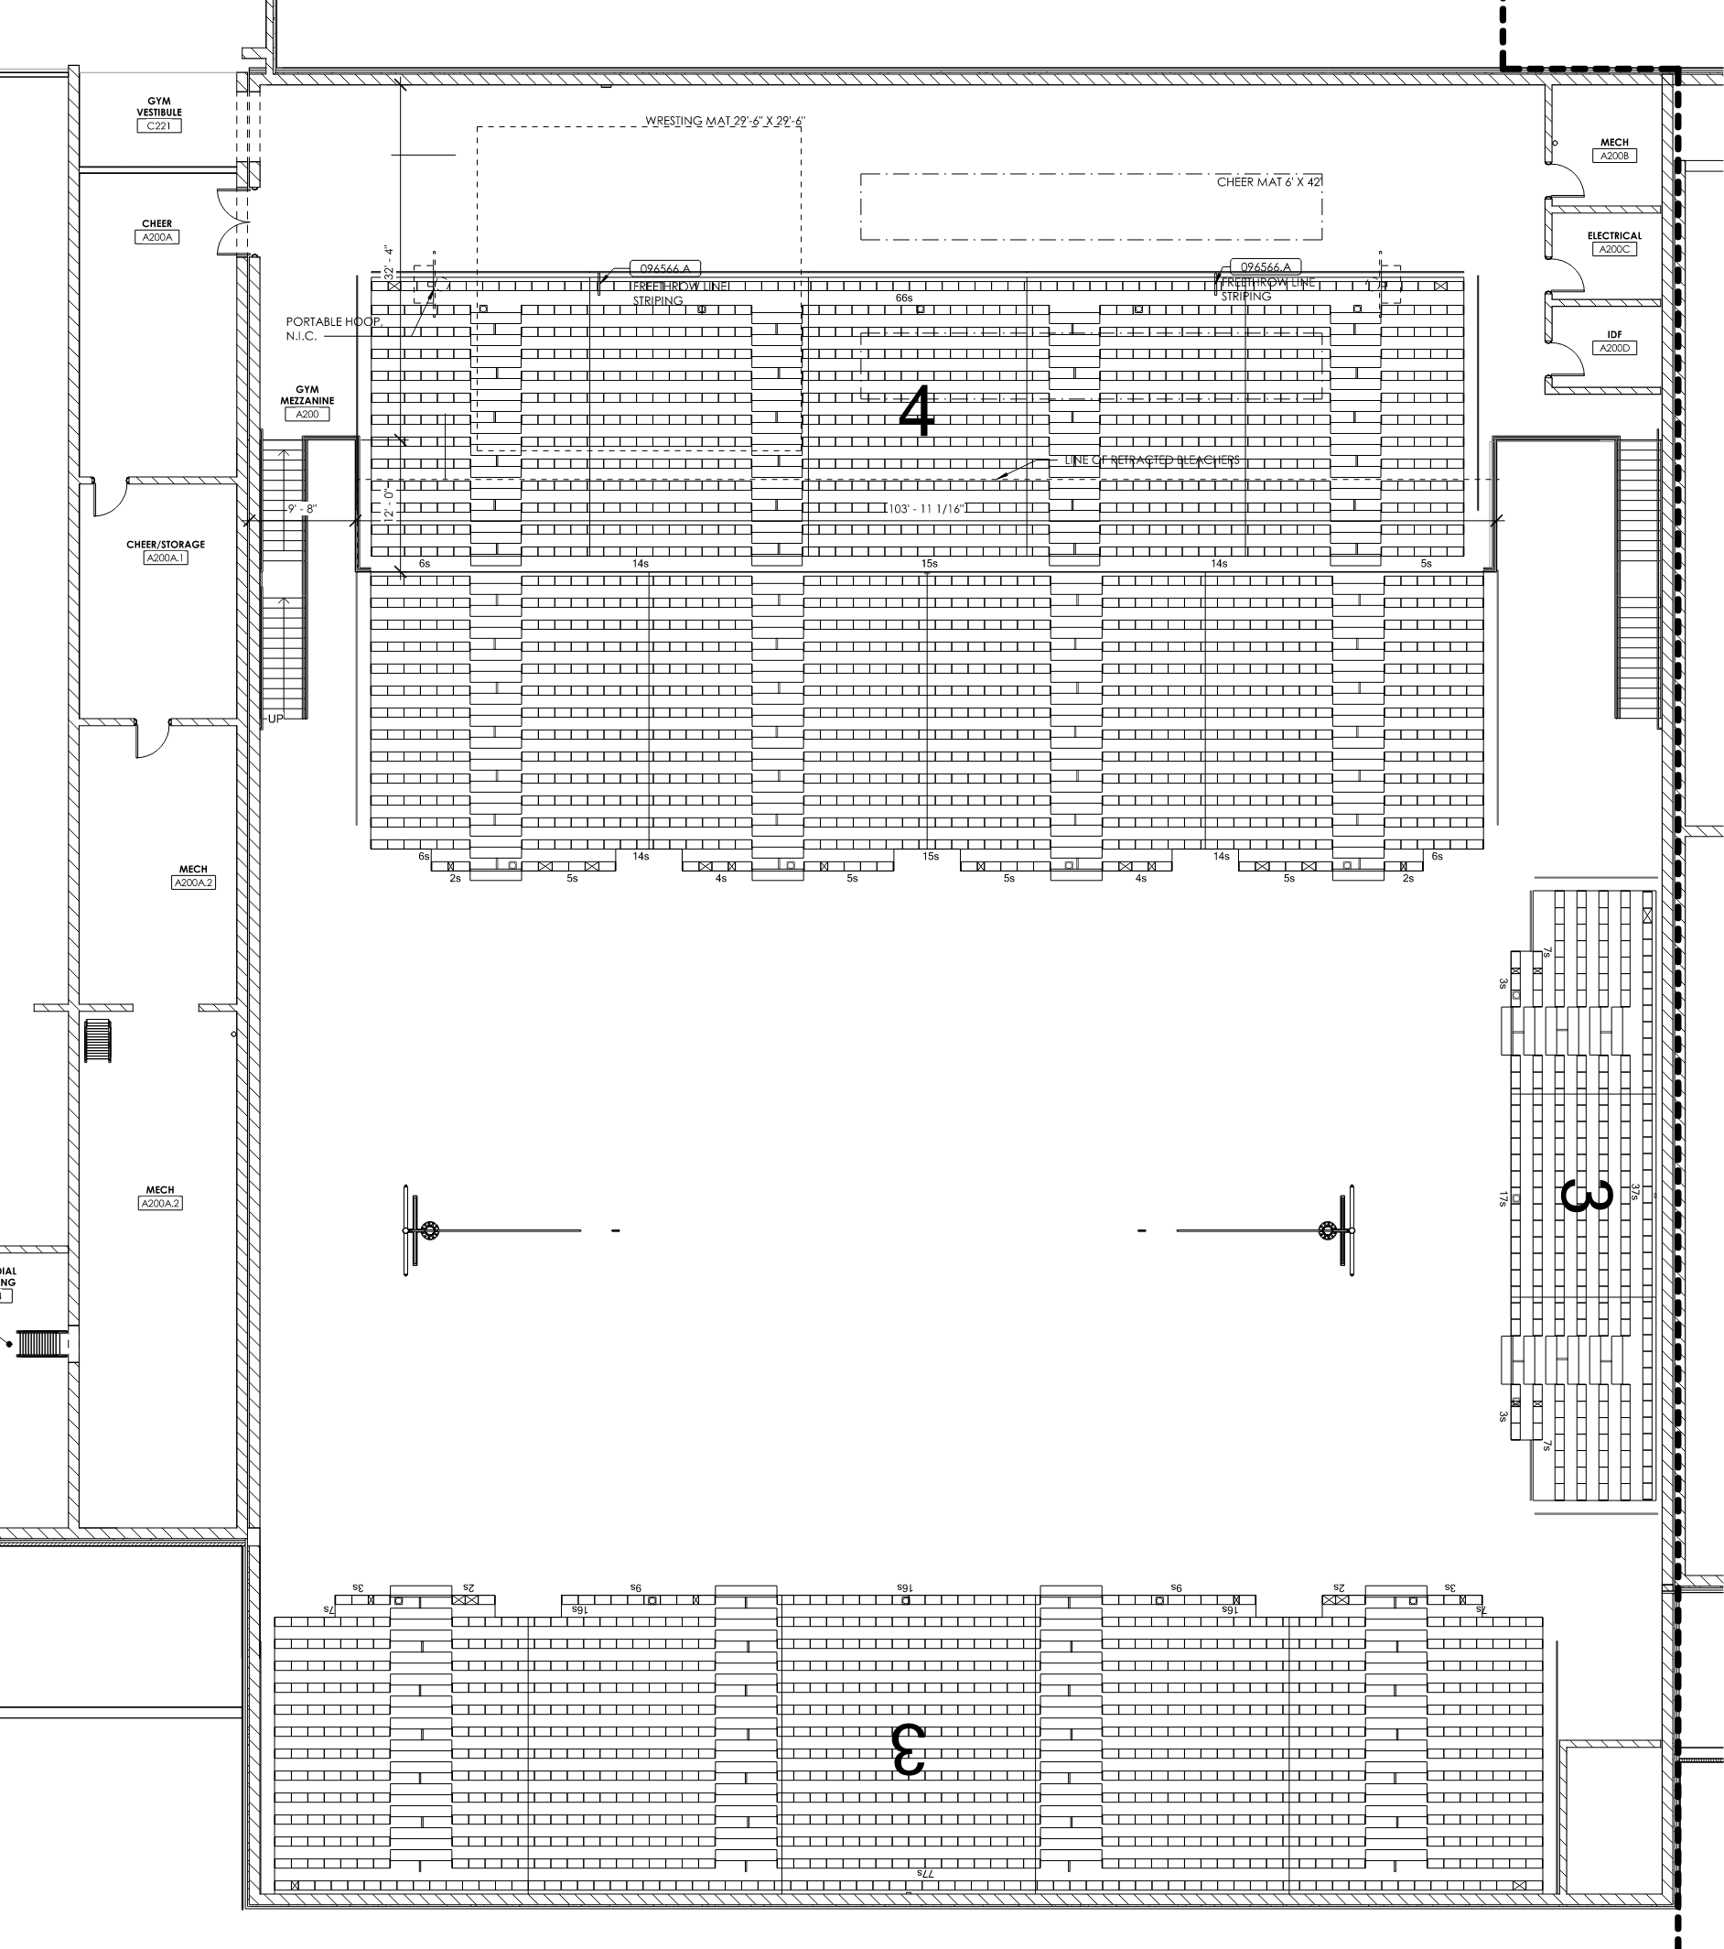
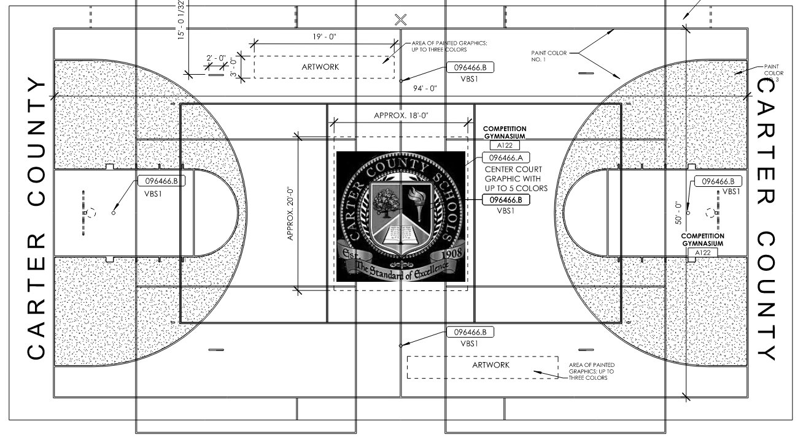
Second Floor Area D
CHEER SPACE / STORAGE
COMPETITION GYM MEZZANINE

Slide 52
Second Floor Area D
COMPETITION GYM MEZZANINE

Slide 53
Second Floor Area D
CHEER SPACE AND STORAGE

Slide 54
Phase 3: Building Schedule

Slide 55
Questions?

